Slide 1
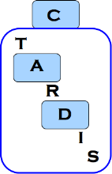


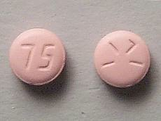
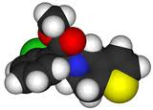
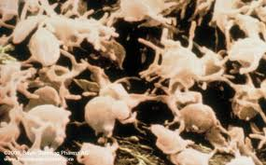
Triple Antiplatelets for Reducing Dependency after Ischaemic Stroke
www.tardistrial.org
Parallel Session

Slide 2
TARDIS: Who’s who
Trial Manager – Di Havard
UK Coordinators – Margaret Adrian, Michael Stringer & Jamie Longmate
International Coordinator – Jo Keeling, & James Kirby
Follow up Coordinators - Jo Keeling, James Kirby & Jenny Smithson
Programmer – Richard Dooley
Data & Imaging – Dawn Hazle
Administrator – Yvonne Smallwood
Statistician – Lisa Woodhouse
Tel: +44 (0) 115 823 1770
Fax: +44 (0) 115 823 1771
Email: tardis@nottingham.ac.uk
Websites: www.tardistrial.org
www.tardistrial.org

Slide 3
UK coordinator sites
Marg – 0115 823 0210
Mike – 0115 823 1910
Jamie – 0115 823 1689
www.tardistrial.org
Notes:
Sites need to be added

Slide 4
Loading doses
Ensure 300mg of aspirin and clopidogrel are given on the day of randomisation
If 75mg has been given before randomisation please make up remainder of dose ie. 225mg
If randomisation is not on the day of admission and 300mg aspirin has been given, a further 300mg must be given on the day of randomisation
www.tardistrial.org

Slide 5
Invoices
Please advise your finance department not to send invoices to the coordinating centre
Payments are made automatically on receipt of patient documentation and scans
Valid Consent
Carotid doppler report
Patient details
Drug Chart
Baseline scan report
Clinical scan
(if applicable)
Baseline scan
www.tardistrial.org

Slide 6
Patient details
Please ask the patient for:
Main contact number
(landline and mobile number if possible)
Relative contact number
It is essential that we have as many numbers as possible in order to conduct the Day 90 follow up
www.tardistrial.org

Slide 7
Patient details
Please ensure that you include the NHS number
This is needed to check the participants status before follow up at Day 90
www.tardistrial.org

Slide 8


Faxes
Fax issues explained
www.tardistrial.org

Slide 9
Frozen samples
Please inform the coordinating centre as soon as possible if you have any issues with frozen samples
Please do not throw away any samples which have defrosted, we will arrange for immediate collection
www.tardistrial.org

Slide 10
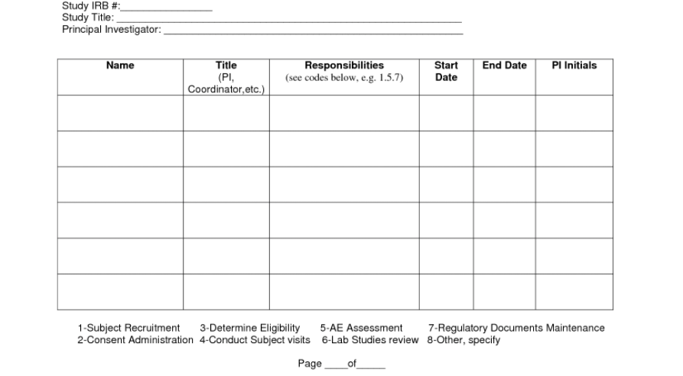
Delegation Log
Please remember to add new staff to the delegation log and send CV/GCP with the updated log to the trials office
www.tardistrial.org

Slide 11
Randomisation
For randomisation queries
Please call the trials office on:
0115 823 1770
or your coordinator
Please do not send randomisation queries to the TARDIS inbox
www.tardistrial.org

Slide 12
TARDIS Parallel session
Questions?
www.tardistrial.org

